Slide 1
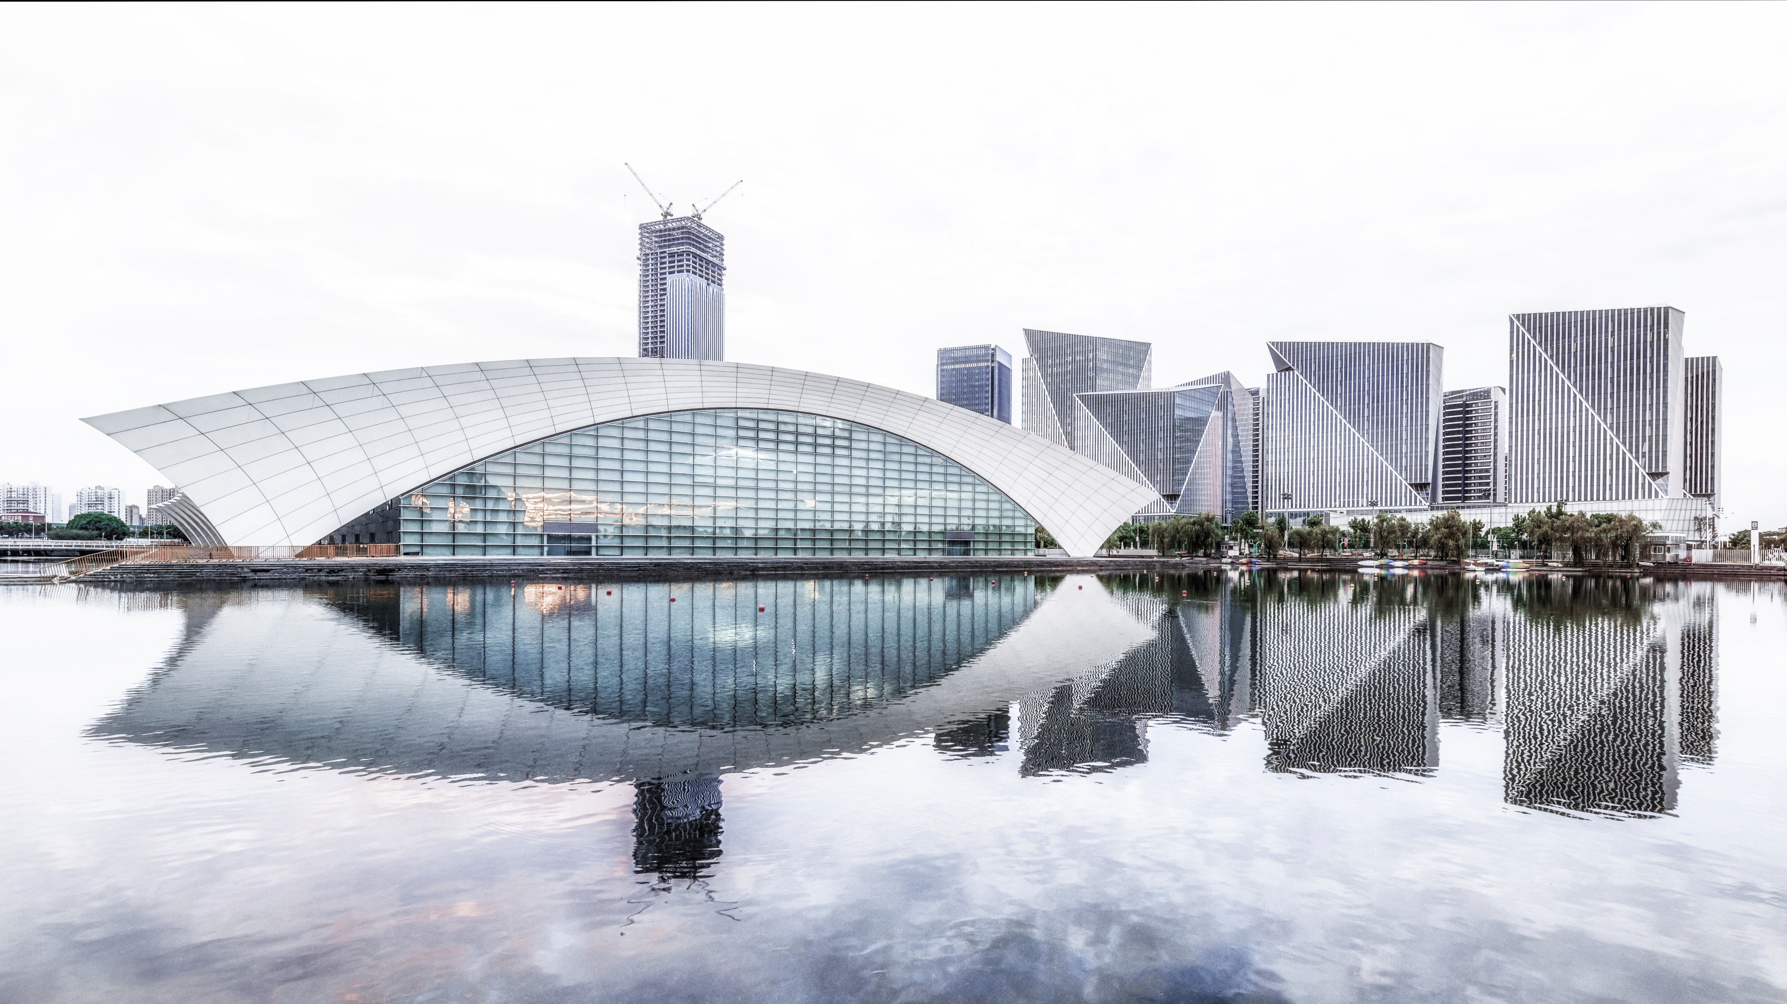



3D Object Detection
Lyft 3D Object Detection for Autonomous Vehicles
Team NO.8

Slide 2
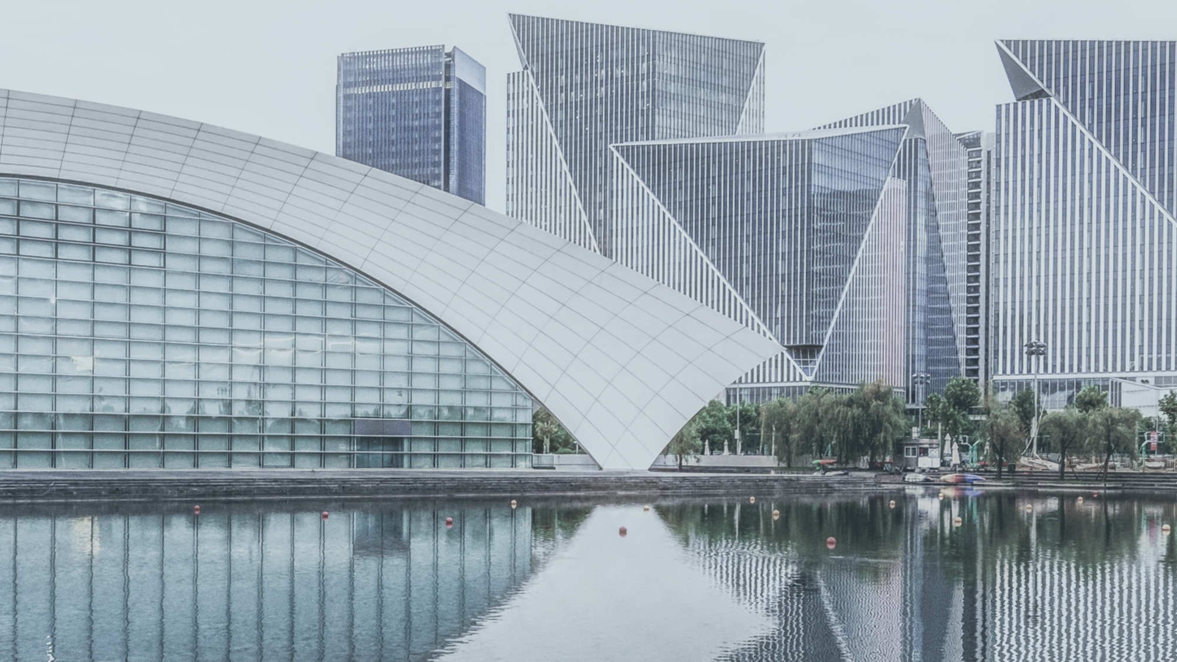
CONTENTS
01
02
Product Definition
Product survey
03
System design

Slide 3

Product Definition
01
>>Product Mission
>> Target User(s)
>>User Stories
>>MVP

Slide 4
Product definition
01
To improve the quality of life by optimizing self-driving technology, which can lead to fewer accidents and easier commutes. 3D object detection over semantic maps is a primary problem in the development of autonomous driving technologies.
The product mission is to use machine learning and computer vision techniques to improve this object detection. We do this by predicting the bounding volume of all the objects in a given scene/picture and classifying them into different classes.
Product Mission

Slide 5

Product definition
01
Target user: Lift
This product in particular is being developed for a specific client/target user- Lyft.
Apart from Lyft, any company which is looking to manufacture, sell or use automated self-driving cars, such as Tesla, Uber, Toyota etc. would benefit from this product.

Slide 6
User Stories from
Lyft
I, Lyft, would like a software that can differentiate between different types of vehicles, living and non living objects, and traffic signs.
I, Lyft, would like a software that can accurately tell me the bounding volume, center, width, length and height of a given object in the picture.
I, Lyft, would like to use only the raw camera and lidar sensor inputs in order to facilitate autonomous driving, without any other sensors.

Slide 7
User Stories from
others
I, the researcher, would like a software that can automatically annotate/label a picture so I may classify objects of interest to me.
I, a robotics developer, would like a software that can be used by a robot to build a semantically annotated 3D map in real time, to improve robot-human interactions.
I, the car manufacturer, would like a software that can be used in a range of autonomous vehicles, with little modifications.

Slide 8
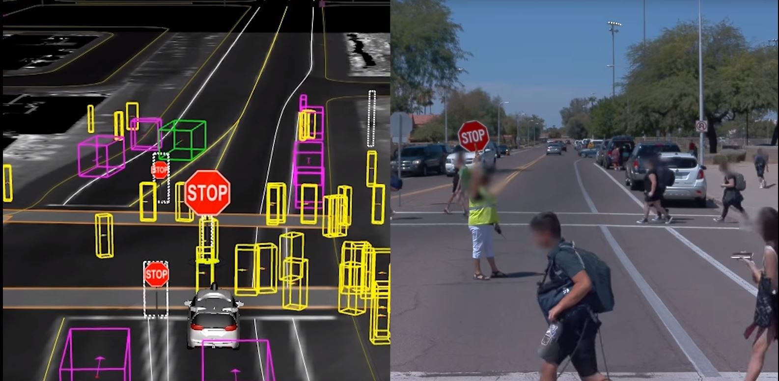
Product definition
01
https://waymo.com/tech/
MVP:
An algorithm which can perform 3D object detection (by returning the volume of the object) over semantic maps (by returning the classification of the object)

Slide 9
Product Survey
02
>>Existing similar products
>> Patent analysis

Slide 10
Product Survey
02
Existing similar products:
There are a large number of project/companies working in the automated car industry. Here is a list of several companies which have been developing and implementing autonomous technologies, similar to the one we hope to develop.
Autopilot projects: Waymo(Google), Apple, Tesla
Automatic Taxi Services: Uber, Zoox, Voyage, Renovo
Automated Buses/Trucks: TuSimple, Navya

Slide 11
Product Survey
02
Out of these, we look more closely at Uber and Waymo, because they are ride-sharing services and Lyfts direct competitors.Uber, Lyft and Waymo are the 3 main companies looking to dominate the autonomous ride-sharing space, and are in constant competition to develop their autonomous systems- in fact, this project itself is a Lyft kaggle competition meant to outsource optimization of Lyft’s algorithms. All the companies are involved in this sort of R&D to optimize their technologies. There is alot of proprietary research and development being conducted on all these algorithms since it is a race to get vehicles on the road as quickly as possible. Our product is simply an algorithm which can perform 3D object classification with semantic mapping, and we can assume that our algorithm will be very similar to the other companies, because they will all require a similar algorithm in order to automate driving. Without 3D mapping and classification it would literally be impossible to automate cars. However, most of these algorithms are heavily protected trade secrets in order to maintain an upper hand. So it is difficult for us to get a clear idea of the competitor space, at least in terms of the exact underlying algorithm that each company is using. However, if we look at the final system into which our algorithm will be implemented- we can see more clearly the differences in driving quality. In the current market, Waymo has begun autonomous ride-sharing in Arizona whereas Uber has had a major setback due to a fatal collision with one of its cars. Lyft has purchased Blue Vision, a 3D mapping company, and partnered with Aptiv to bring self-driving cars to Las Vegas.

Slide 12
System Design
03
>>Technology & Reasons
>> Components
>> Test program

Slide 13
System design
03
Technology
Reasons
that we are going to use
tell you why we choose them
Opencv libraries
Lots of functions such as Kalman filter、Canny、Roberts、Sobel、Prewitt operators and so on. It is an open source library so we can use it directly.
Python language
Don’t need to take care of the data type(int、long int）and the allocation of memory. Easier to write functions.
Point cloud processing
Transform the raw radar data to point map, which is easier to process.
TensorFlow
We use Tensorflow as our tool to build the machine learning model.
Lyft SDK
Lyft SDK could help us read, visualize the dataset.
Triangular
A efficient way to identify the position of an special, and can also used to caculate the height, length, width of the object.

Slide 14
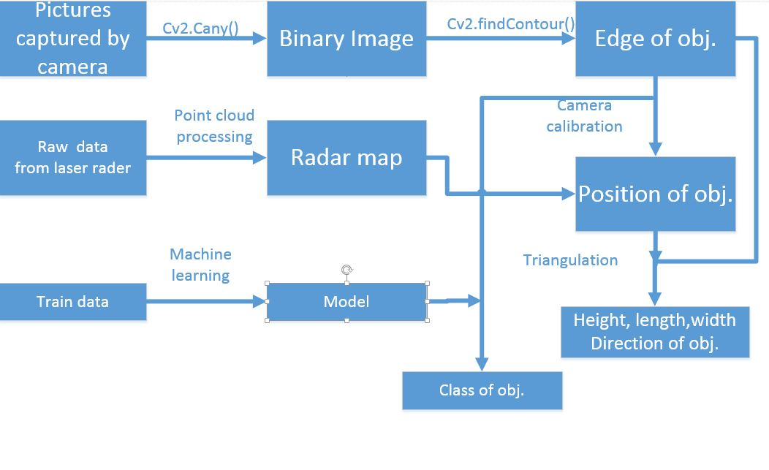
System design
03

Slide 15
System design
03
import cv2 as cv
import numpy as np
import math
imgBus=cv.imread("Bus.jpg",1) imgDes=cv.imread("Desktop.jpg",1) cv.imshow("111",imgBus) imgtest=cv.imread("Bus.jpg",0) imgtest=cv.Canny(imgtest,30,200)
contours,hierarchy=
cv.findContours(imgtest,cv.RETR_TREE,cv.CHAIN_APPROX_SIMPLE) cv.drawContours(imgtest,contours,0,(0,0,255),3) cv.imshow("222",imgtest)
cv.waitKey()
cv.destroyAllWindows()
Test Program

Slide 16
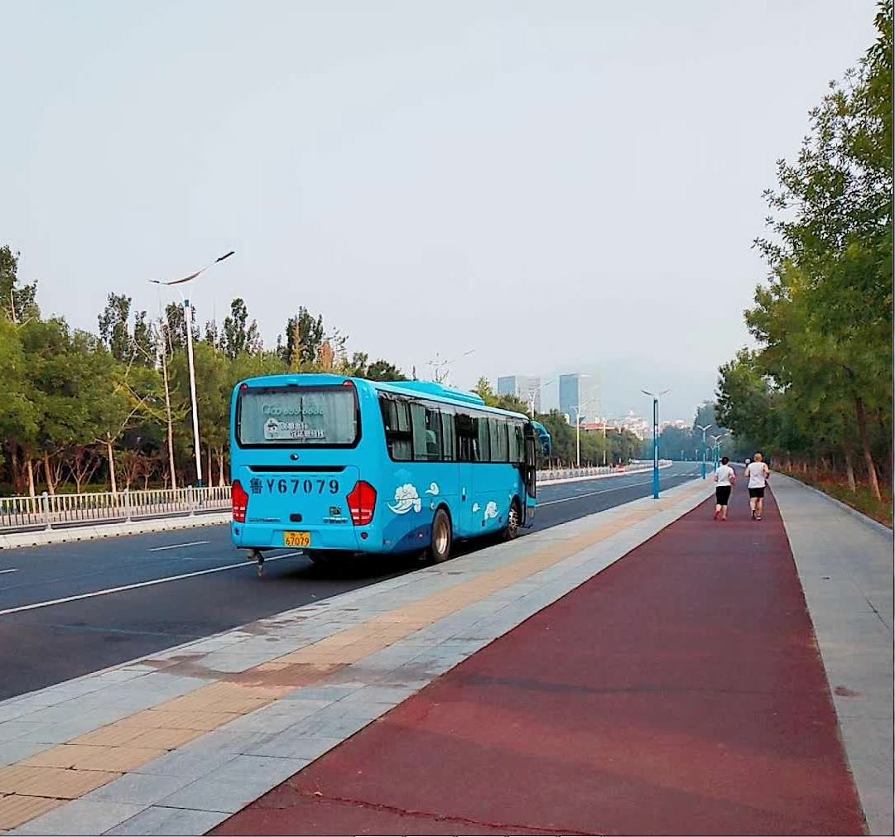
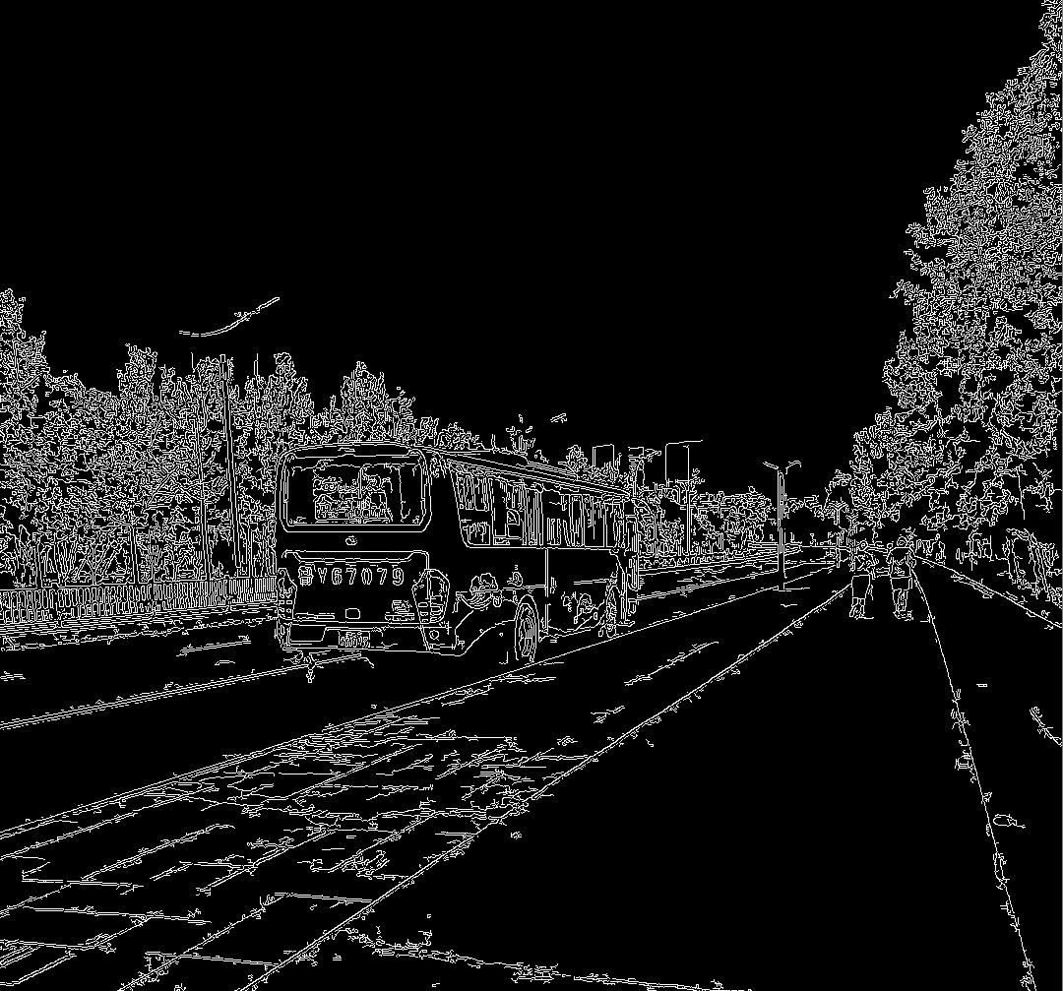
System design
03
Origin
Edge

Slide 17
THANK YOU FOR LISTENING

